Slide 1

MUNICIPALITY OF ŽABLJAK
Investment-development potentials
Trg durmitorskih ratnika 1
84220 Žabljak
Tel +382 52 361 978
Fax +382 52 361 978
www.zabljak.me
predsjednikzabljak@gmail.com
biczabljak@gmail.com

Slide 2
GENERAL INFORMATION
The municipality of Zabljak is located in the northwest of Montenegro and its the largest municipality of Durmitor area. It covers an area of ​​445 km2, which occupies 3.22% of the total area of ​​Montenegro. Zabljak, with its 1456 meters above sea level, is the highest urban settlement in Southeast Europe.
Zabljak has about 3,000 permanent residents. There are 28 settlements on the territory of the municipality, which are organized into 12 local communities, one of which is a city. However, this number of inhabitants is not a realistic representation, because there are a large number of property owners who spend part of the year in Zabljak (during summer and winter season) but live and work in other cities. Including tourists in the height of the summer tourist season in Zabljak and its surroundings, there are between 15 and 20 thousand people
Recognizable on the global level by the National Park Durmitor and Tara river, this area is bordered on the northeast by the municipality of Pljevlja, on the south by the municipality of Mojkovac, on the southwest by the municipality of Savnik, and on the west by the municipality of Pluzine.
In Zabljak, Montenegro was declared an ecological state in 1991, and Zabljak was chosen as its capital

Slide 3
NATURAL RESURCES
National park Durmitor
The narrower area of Durmitor was declared a National Park by the Decision of the National Assembly of the People's Republic of Montenegro from 1952. Law on National Parks MNE from 1978, the borders of the National Park were determined and zones with a special protection regime were separated in them. By the decision of the UN Committee on Education, Science and Culture UNESCO from 1977. the area of the river Tara was included in the ecological reserves of the world and in the Program "Man and Biosphere". By decision of the same Committee of 1980, Durmitor and the Tara River are classified as a world heritage site of natural and cultural values.
The total area of ​​the park is 39,000ha. The largest part of the park's territory is located within the municipality of Zabljak , which is the administrative center. The park also covers the territory of the municipalities: Savnik, Pluzine, Pljevlja and Mojkovac.

Slide 4
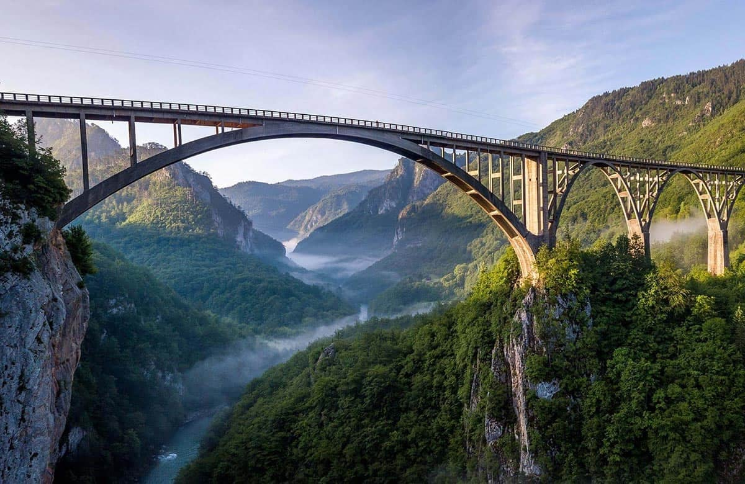
NATURAL RESURCES
TARA RIVER
Powerful rivers with incredible canyons are just some of the beautiful decorations of NP Durmitor.
The Tara River is particularly impressive, not only because of the beauty of its flow, but also because of the landscape and the depth of the canyon, which is one of the most beautiful in the world. The basin of the Tara River (area 182,899 ha) was registered in the Ecological Biosphere Reserve on January 17, 1977, and is therefore protected by the UNESCO Convention on the Protection of World Cultural and Natural Heritage. The massif of Durmitor is registered in IBA and IPA areas (area of ​​important birds and area of ​​important plants).
The Tara River Canyon, unique in its depth, in some places up to 1300m, is the second deepest canyon in the world, after the Colorado Grand Canyon in the USA. The course of the Tara River is 150 km long, and it is the longest river in Montenegro.

Slide 5
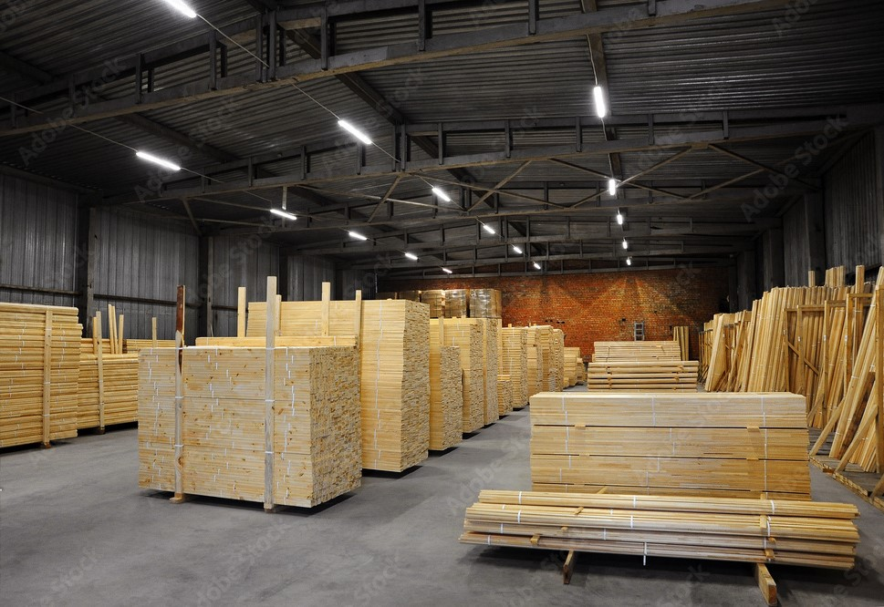
NATURAL RESURCES
FORESTS(WOOD PROCESSING)
Forests represent one of the important resources in the area of ​​the municipality of Žabljak. Large forests areas enabled the development of the wood industry and wood processing. The total area of ​​forests and forest land is 8,517ha of state and 756ha of private forests (total 9,273ha).
In high economic forests, the main function is the production of wood and secondary forest products, and in special purpose forests - protective recreational functions.
The forests are arranged within three economic units, namely:
«Tepačke šume», «Gornji Šaranci», i «Donji Šaranci».

Slide 6
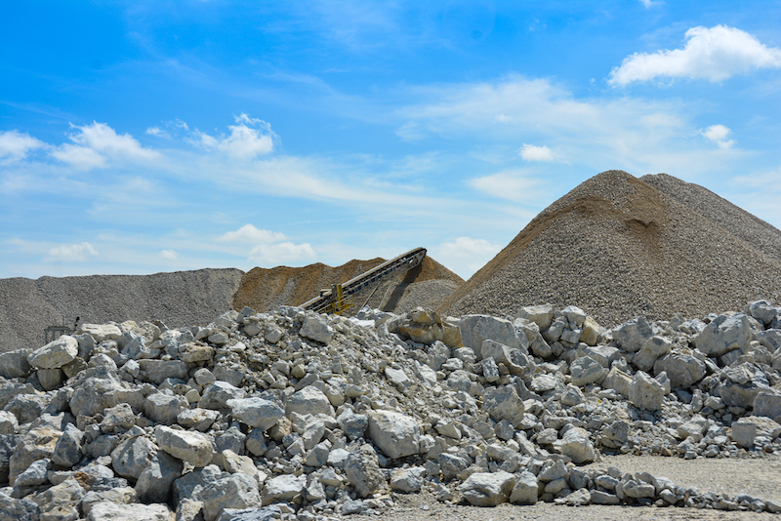
NATURAL RESURCES
MINERAL RAW MATERIALS
Mineral raw materials that can be found in nature in the area of ​​Žabljak are: gravel, sand and stone. Bearing in mind that the area of ​​the municipality is of glacial origin and that these raw materials are abundant, they represent a significant natural resource.
Exploitation is carried out in two maidans: Njegovuđa and Razano Polje. Existing raw materials have proven to be quite good building materials. So far, only experimental concessions have been allowed.

Slide 7
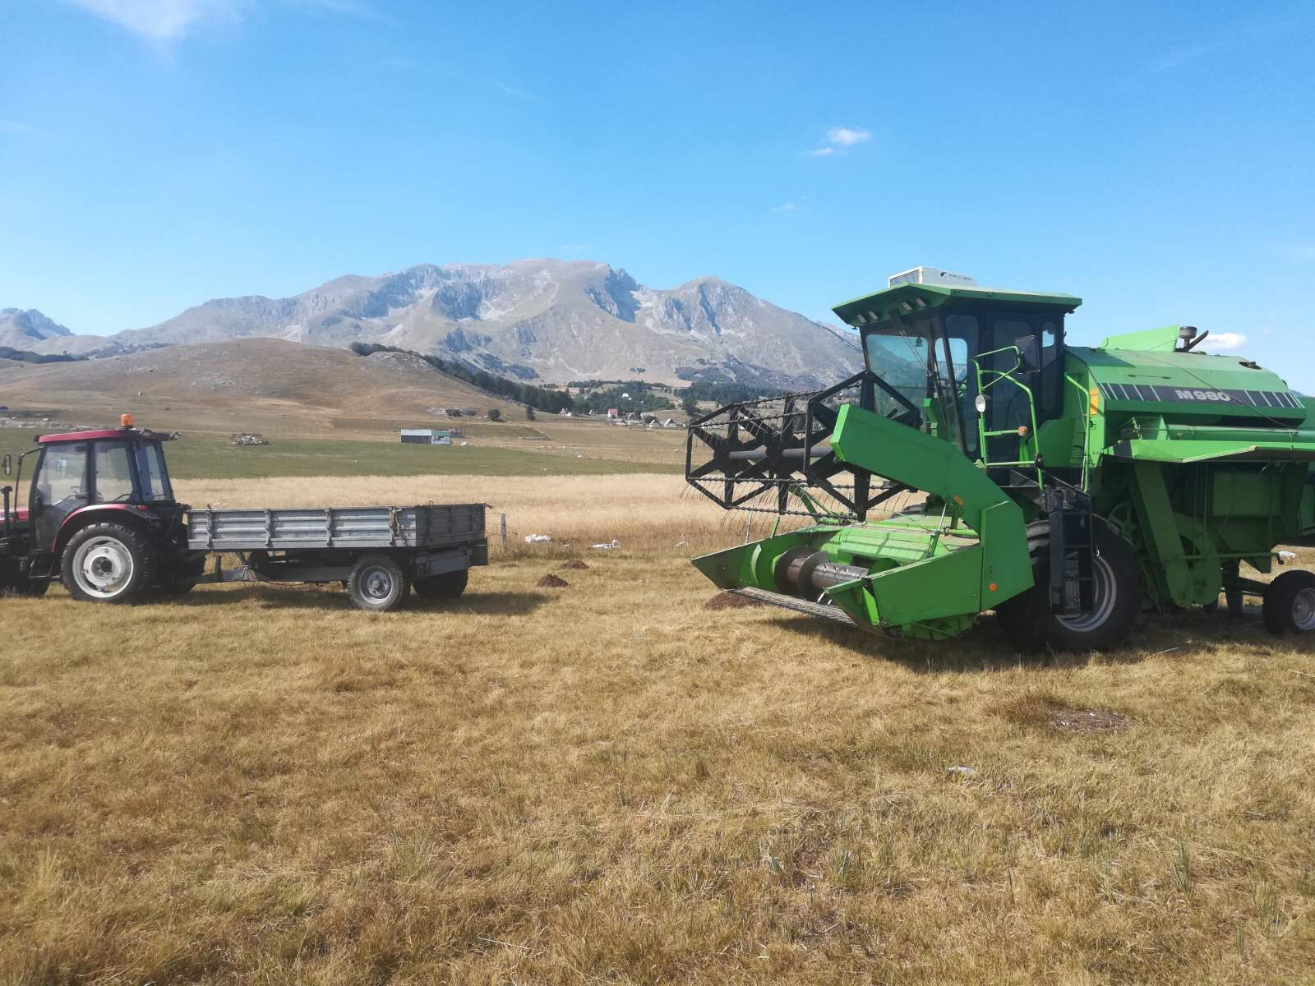
NATURAL RESURCES
LARGE AGRICULTURAL AREAS
Land is one of the main factors in agricultural production in this area. Large agricultural areas provide opportunities for the development of agriculture, animal husbandry and farming. The development of agriculture has recently stagnated due to the fact that agriculture is exclusively carried out by elderly household
Bearing in mind the possibilities for agricultural production, in practice it has proven to be economically justified organic production, both in farming and in animal husbandry. There are already entrepreneurs who have certificates for organic production. Agricultural land mainly consists of pastures and meadows, with smaller areas represented by arable land and gardens.

Slide 8

WHY INVEST IN ZABLJAK?
As a small and very open economic system, Montenegro has the ability to quickly adapt to world trends in direct foreign investment. Therefore, the investment environment as a whole has improved.
According to an analysis that was done in Slovenia, a few years ago, on the perspective of potential investments in Montenegro, Žabljak was placed at the top of the pyramid! That official recommendation given to their companies in Slovenia has already started some Slovenian projects in Žabljak and in New investment projects are under discussion.
Perfect conditions and predispositions for investments in tourism, agriculture and wood processing industry.

Slide 9
WHY INVEST IN ZABLJAK?
BENEFITS FOR INVESTORS THAT MONTENEGRO OFFERS
Political, monetary and macroeconomic stability
Simple START UP
Liberal economic regime of foreign trade,
Favorable tax policy
International accounting standards
Growth of economic freedoms
Geographical location and climatic conditions
On the basis of the principle (member) of the World Trade Organization, Montenegro is a signatory to multilateral and bilateral agreements - the Stabilization and Association Agreement with the European Union, CEFTA 2006, EFTA, Russia, Belarus and Turkey, which enables it to accumulate origins and duty-free trade with around 800 million consumer.

Slide 10
Incentive measures offered at the state level for existing businessmen and new investors
Links to the pages of state authorities
REGULATION ON ENCOURAGEMENT OF DIRECT INVESTMENTS
https://wapi.gov.me/download-preview/bd315acb-5beb-4f8b-88c7-c523be37e309?version=1.0
LAW ON FREE ZONES
https://wapi.gov.me/download-preview/54835738-6cc8-4795-9323-a02f0e0d6ee8?version=1.0
REGULATION ON SUBSIDIARIES FOR EMPLOYMENT OF CERTAIN CATEGORIES OF UNEMPLOYED PERSONS
https://wapi.gov.me/download-preview/5cd96687-d93e-453e-ad92-7a1446803a24?version=1.0
SUPPORT PROGRAM FOR THE MODERNIZATION OF THE PROCESSING INDUSTRY
https://wapi.gov.me/download-preview/fc833140-940b-4f0f-a29d-c8930436c41d?version=1.0

Slide 11
Benefits that the Municipality of Žabljak offers
Possibility to pay the agreed fee for communal equipment of construction land in installments (25% of the agreed amount is paid on the day of signing the contract on communal equipment of land, and the rest in the next 3 years);
If the fee is paid at once, it is reduced by 15%;
There is also a possibility for the investor to independently perform communal land equipping;
The real estate tax rate according to the Real Estate Tax Act is proportional and amounts from 0.25% to 1.00% of the market value of the real estate. According to the valid Decision on real estate tax of the Municipality of Žabljak tax rates are minimal:
Tax rates range from 0.27% for residential buildings under construction, to a rate of 0.54% for secondary housing;
Regarding facilities important for investment and business development, rates are very low, bearing in mind that they can be defined by law up to 1%:
For business facilities and business premises (business buildings, business premises and apartments converted into business premises) - 0.41%
For production facilities (halls and other premises for performing production activities) - 0.31%
For warehouses -0.26%
For a hospitality facility located in the zone of a priority tourist locality that is in operation 12 months a year, the tax rate may be reduced: for a category of 4 **** - 20%; and categories over 4 **** - 50%
Regarding to the Law on Spatial Planning and Building Construction ("Official Gazette of Montenegro", no. 64/17, 44/18, 63/18, 11/19, 82/20, 86/22 and 4/23), condo hotels are exempt payment of fees for utility equipment. When the request for calculation is submitted, a decision is made on temporary exemption, and when the condo hotel receives a decision on co-categorization - a decision is made on exemption from the fee for utilities in general.
Land used for agricultural purposes is exempt from tax;
Support to micro, small and medium enterprises through the work of Business info center;
Support to agricultural producers through the work of the Agrobusiness Info Center;
Participation of local government in agricultural insurance, in milk purchase, in meat production and plant production
Support for the establishment of associations and clusters;
Support to employment through cooperation with the Employment Service on numerous projects and organization of trainings for acquiring new knowledge and skills of unemployed persons.

Slide 12
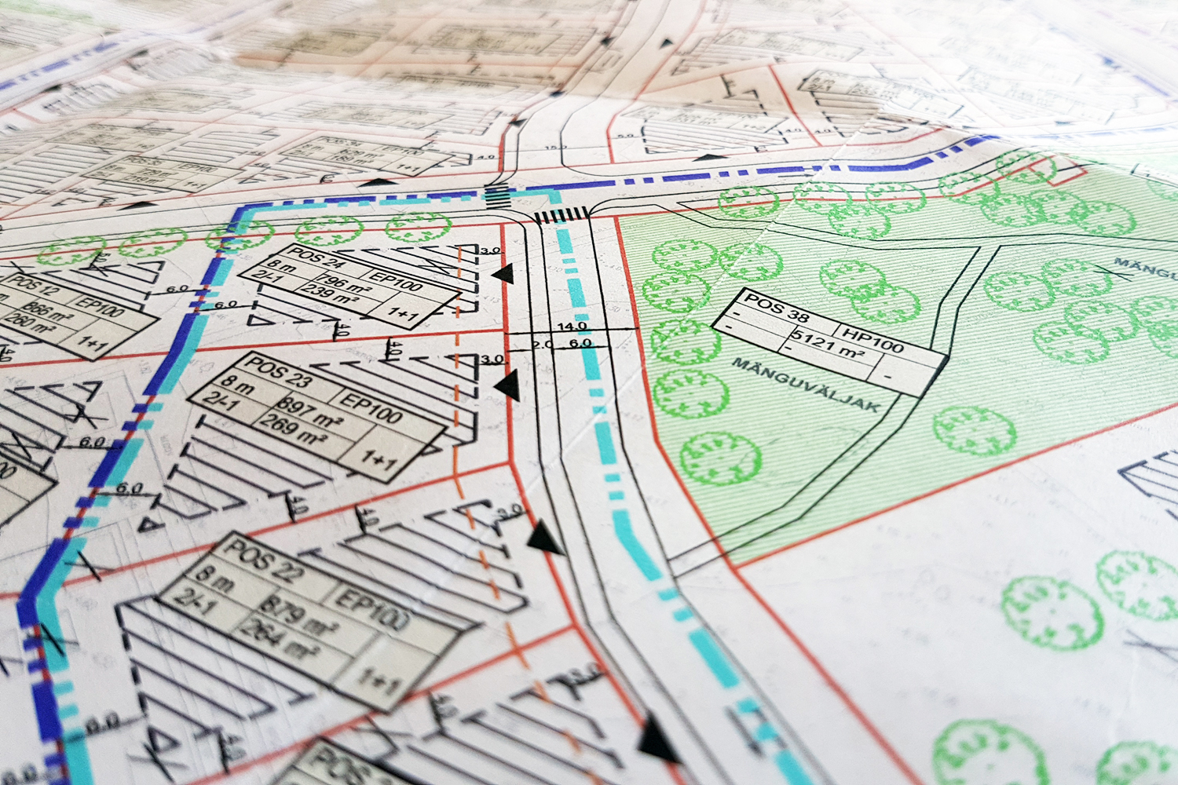
Business zones/industrial locations
The spatial urban plan of the Municipality of Žabljak defines zones for business development, namely:
1. Business zone Njegovuđa: Njegovuđa and Pilana, Njegovuđa II
2. Business zone Vruljci;
3. Zabljak work zone;
4. Service area
Within these 4 zones there are the following locations suitable for investment:

Slide 13
Business zones/industrial locations
Location: Njegovuđa II
Address: Njegovuđa
Ownership: private
The size of the urban plot is approx. 4 ha
Purpose: industry and production
2. Location: Žabljak I
Address: Narodnih heroja bb (Klještina)
Business zone: Service zone
Ownership: 100% public
The size of the urban plot is 5,113m2
Purpose: industry and production
3. Location: Žabljak II
Address: Narodnih heroja bb (Klještina)
Business zone: Service zone
Ownership: 100% public
The size of the urban plot is 21,527 m2
Purpose: industry and production

Slide 14
Business zones/industrial locations
Location: Žabljak III
Address: Narodnih heroja bb (Klještina)
Business zone: Service zone
Ownership: 100% public
The size of the urban plot is 2,049 m2 Purpose: industry and production
5. Location: Žabljak IV
Address: Narodne heroja bb (Klještina)
zone: Service zone
Ownership: 100% public
The size of the urban plot is 1,372 m2
Purpose: road traffic (gas station)
6. Location: Žabljak V
Address: Narodnih heroja bb (Klještina)
Business zone: Service zone
Ownership: 100% public
The size of the urban plot is 1,418m2
Purpose: industry and production

Slide 15
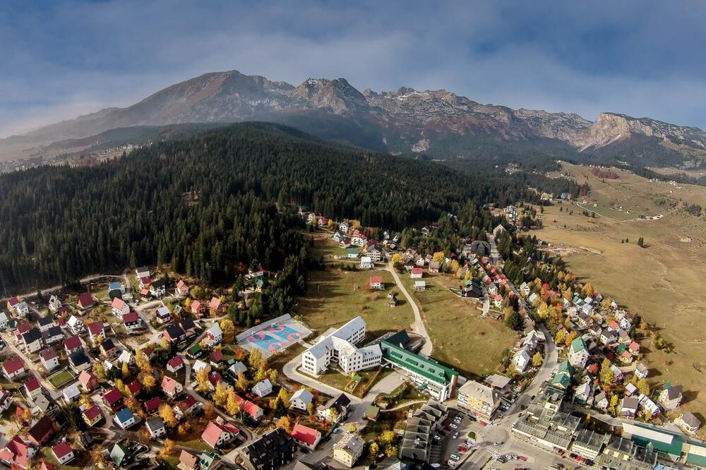
GREENFIELD LOCATIONS
Location of the former military barracks
size: 13,502 m2
property: public/state of Montenegro
2. Location of Enigma II
size: 1,226m2;
property: public/Municipality of Žabljak
3. Location next to MUP residential building
size: 1,829m2;
property: public/Municipality of Žabljak
*More informations:
https://zabljak.me/docs/1715597145-Greenfield%20location%20datebase.pdf

Slide 16
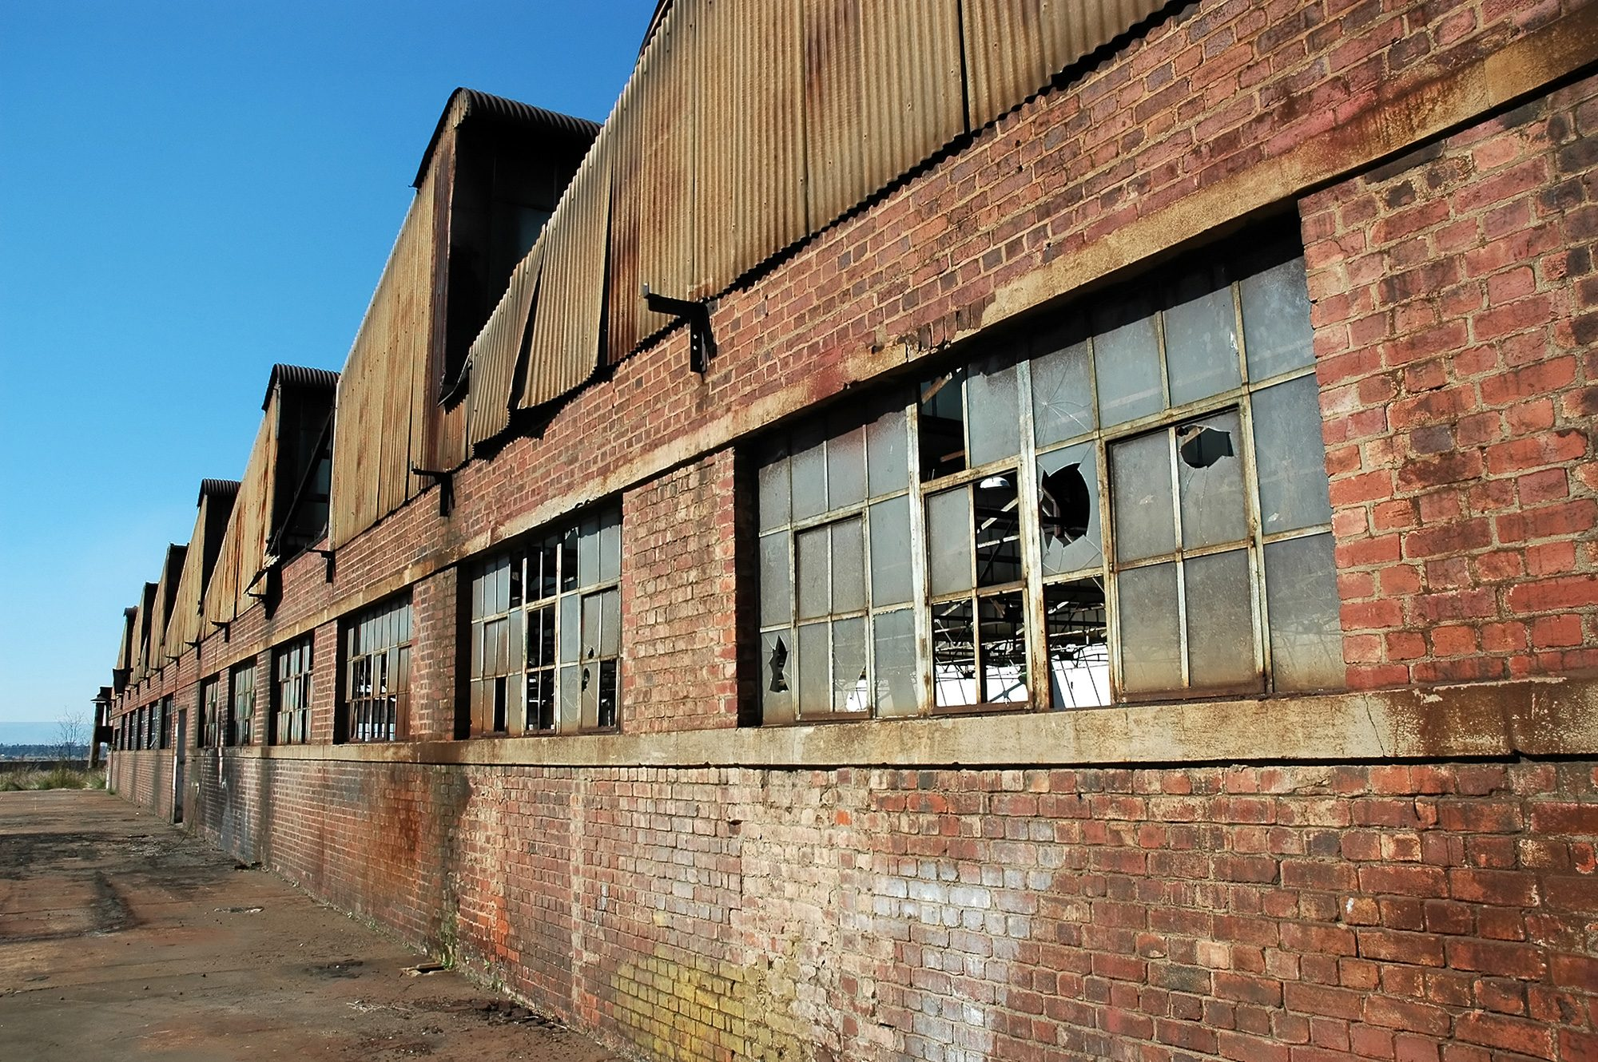
BROWNFIELD LOCATIONS
1. Location of the old hospital
size: 431m2;
property: public/state of Montenegro
2. The location of the former
sawmill on Njegovuđa
size: 76,146m2;
ownership: private
More informations:
https://zabljak.me/docs/1715596920-Brownfield%20location%20datebase.pdf
3. Location of the bus station
size: 1,480m2;
property: public/state of Montenegro
4. Location "Gorske oči"
size: 9,338m2;
property: public

Slide 17
Business info center
In the Municipality of Žabljak is established a "Business Info Center" was in Žabljak, which represents an informal organization unit within the Mayor’s Office, wich primarily deals with the services of the local administration intended to micro, small and medium enterprises.
BIC was formed with the aim of developing entrepreneurship and creating a more favorable business environment, and in the first steps it is oriented towards providing the necessary information for the establishment or development of a business, and with consulting and mentoring support, support through the transfer of knowledge and skills, and networking at the local and national level, it has in order to contribute to the creation of a stimulating environment for business development.
BIC is a place where you can find the necessary information and support for developing a business idea and starting a private business. Then there is information related to running a business, access to information related to obtaining financial resources, finding business partners and the possibility of competing with projects on various invitations. In addition, the BIC is a useful physical space for all those who need basic infrastructure to work on their business ideas, but also a place to exchange and connect resources and ideas.

Slide 18
Tourist facilities
There is a Tourist Organization in Zabljak, which is an main institution for all local actors involved in tourism.
DOO Sports Center Zabljak contributes to the development of sports and sports culture in Žabljak, and it is quite equipped wich make Zabljak seriously include sports tourism in its offer. What is offered is a sports hall, 3155 m2 equipped with: a handball, basketball, volleyball and futsal court with 548 seats, an ambulance and sanitary facilities, a bowling alley, a coffee bar and a gym.
Ski resort Durmitor (Savin kuk) has two two-seater lifts, three ski lifts, one of which is equipped with floodlights for night skiing, as well as one children's ski lift. This infrastructure serves a total of 4.6 km of ski trails and has a capacity of 3,000 skiers. The ski resort has three blue trails, one red trail, one black trail and a children's, baby trail., There are potentials for the development of new ski slopes in Žabljak, and reconstruction of the ski resort "Štuoc“.
In terms of tourist capacity, Zabljak have:
10 hotels;
2 pansion;
110 rooms in hotels;
498 bed in hotels;
79 apartment in hotels;
572 private apartments;
3498 bed in private accommodation
In 2023. there was:
145 000 tourists;
50 000 overnight stays.

Slide 19
Tourist zones
Developmental tourist zones :
Virak-Motički Gaj;
Borje- Tepačko Polje;
Vrela;
Njegovuđa;
Uskoci, Čardak I Poljane;
Pašina Voda
Smaller tourist areas:
Podgora;
Tepca- Begovo Polje;
Turistička naselja

Slide 20
AGRICULTURAL POTENTIALS
Agriculture, together with tourism, is the basis of future economic development of the municipality of Zabljak. The proclamation of Montenegro as the first ecological state in the world further justifies such a development orientation. The available agricultural production potentials, regardless of certain restrictions, which the Durmitor area has at its disposal, are unavoidable in creating the development of the entire Montenegrin agriculture.
In the last few years, as part of agricultural activities, Žabljak has experienced an expansion of rural tourism. Rural tourism creates conditions to meet the needs of an increasing number of tourists who strive for a healthy lifestyle and seek experiences that include pleasure in nature, traditional cuisine, hospitality of households in rural areas, enjoying tradition and preserved customs and other authentic experiences.
On the territory of the Municipality of Zabljak for performing related tasks in the area of improving agricultural production, Agribusiness info center is is in charge to provide advisory support reduces administrative barriers, implement state agrobudget measures, create programs of subsidies tailored to local farmers, promote local products, facilitate the process of marketing agricultural products, perform free business making plans for IPARD and others programs of respective ministry.

Slide 21
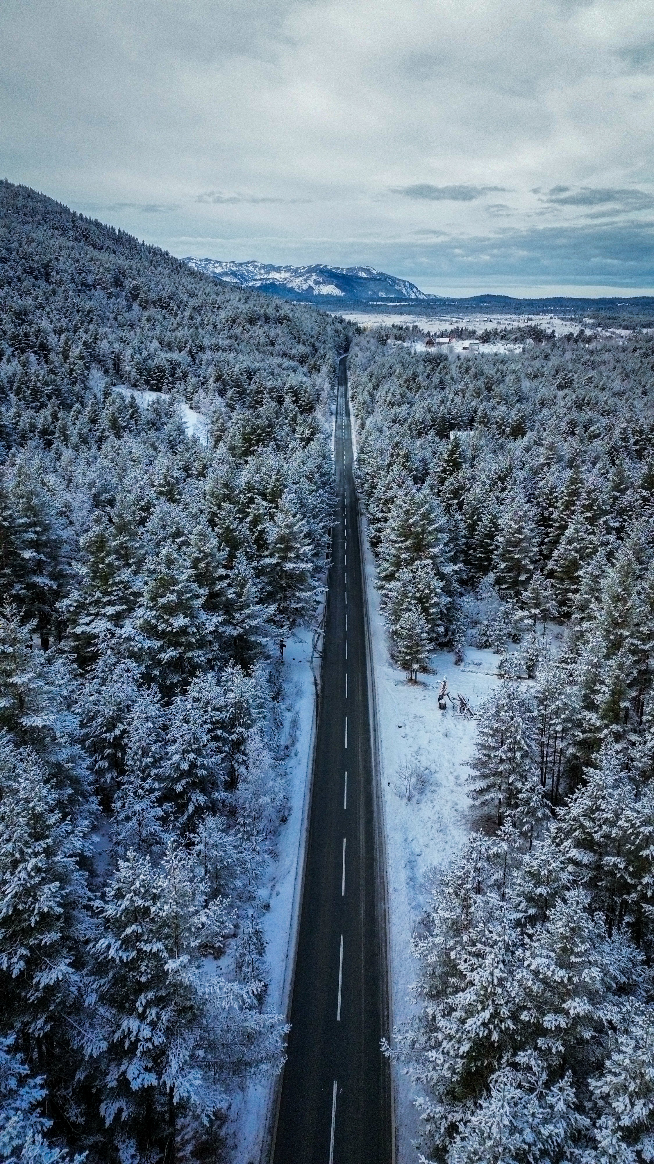
Road infrastructure and traffic communication
It is very easy to get to Žabljak. In 2010, the Risan-Zabljak road was opened and thus the distance between the Zabljak and the Montenegrin coast was shortened, and now you can get from Žabljak to the Montenegrin coast and Adriatic sea in 2h-2h30min.
The capital, Podgorica, is about a 2 hour drive from Žabljak (120 km). Distance from other regional centers: Belgrade-400km; Sarajevo-167km; Zagreb-535km; Tirana-270km; Skopje-337km; Ljubljana-674km,
The nearest port is Bar (Montenegro) - 197 km. It is possible to travel from Bar to Mojkovac by train(70km from Zabljak), and then by bus to Žabljak.
Nearest airports: Podgorica (120 km), Tivat (250 km), Dubrovnik (260 km).

Slide 22
Road infrastructure and traffic communication
BORDER CROSSINGS
Serbia – Zabljak 70km. If you are coming from Serbia, you can cross the border in Prijepolje, then through Pljevlja and you will reach Žabljak (the distance from the Jabuka border crossing is 70 km). It can also be reached via Bijelo Polje and Mojkovac (border crossing Brodarevo - 110 km).
If you are coming from Croatia, from the direction of Dubrovnik (border crossing Debeli Brijeg), you can arrive via Herceg Novi, Risno and Nikšić (200 km) or via Dubrovnik-Trebinje-Nikšić-Žabljak (170 km).
If you come from Bosnia and Herzegovina, via Foča and the Šćepan Polje border crossing thne Niksic – Savnik - Zabljak, the distance from the border crossing is 150 km. You can also use other route via Plužine and Durmitor directly to Zabljak. If you enter the Metaljka border crossing, via Goražde, Ćajniče Pljevlja, the distance is 87 km.
From Zabljak in just few hours of driving you can reach Serbia, Albania, Bosnia and Croatia

Slide 23
MUNICIPALITY OF ŽABLJAK
Investment-development potentials
THANK YOU
FOR YOUR
ATTENTION
Trg durmitorskih ratnika 1
84220 Žabljak
Tel +382 52 361 978
Fax +382 52 361 978
www.zabljak.me
predsjednikzabljak@gmail.com
biczabljak@gmail.com

